Slide 1
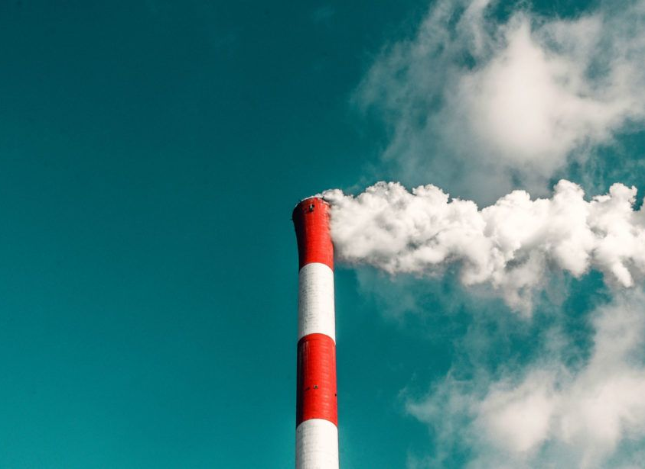
Trump vs climate
Has the American president’s crusade against the environment had an effect yet?
Notes:
Intro
I wanted to know, specifically, whether Donald Trump’s inauguration on January 20th, 2017 has had a meaningful impact on the total generation of renewable or fossil fuel energy in the United States.

Slide 2

Notes:
The Commander in Chief has been president for just over 2 years and 3 months.
His administration is undeniably pro-fossil fuels, a major contributor to the atmospheric CO2 that worsens climate change.
Here are a few of the climate-related claims he has made:
He has said he will pull the US out of the Paris international climate agreement.
He has cut the budget of the US Environmental Protection Agency, and put lawyers from the oil and gas industry in charge of it, leading to the rollback of 47 environmental regulations, a halving in the number of fines issued by the agency, and a net loss of 1200 agency employees.
He is famously on record as saying that global warming is a hoax perpetuated by the Chinese, and when asked about the recent Fourth National Climate assessment, compiled by his own government and detailing the devastating effects that unchecked climate change would have on America, Trump countered the 1524 pages of science with just four words: "I don't believe it".
Intro to the scraper – scraping the US Energy Information Administration tables of renewable and fossil fuel energy using scrapy.
Info was in slightly disparate parts of the site, but thankfully all structured the same so basically ended up building several, very similar srapers.

Slide 3
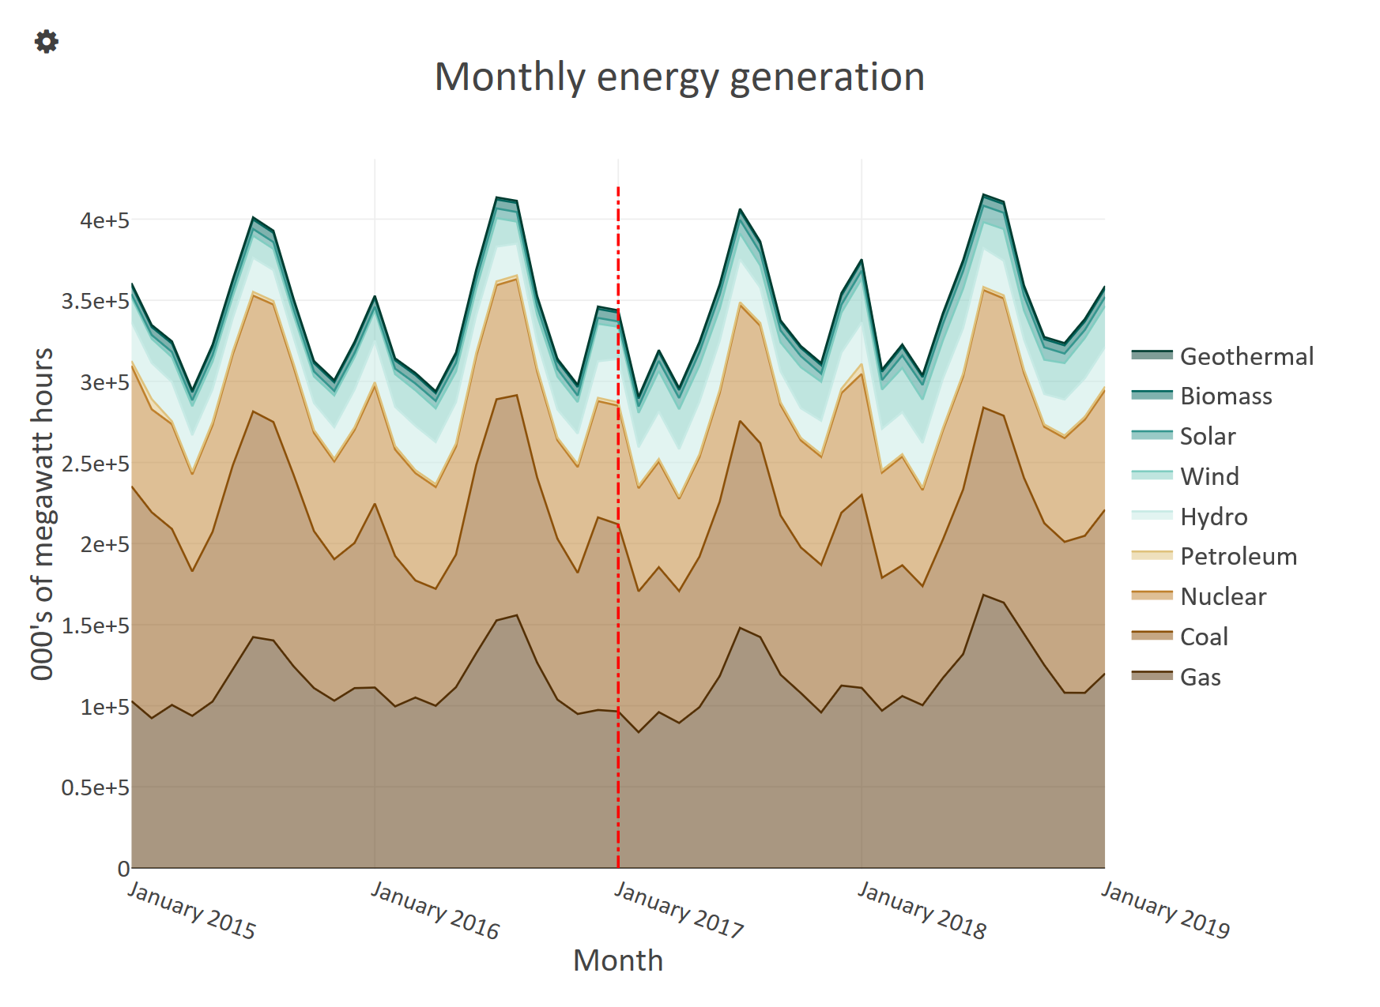
Notes:
And after a little bit of tidying, this is the high level result.
Shows US energy generation between Jan 2015 and Jan 2019, in thousands of megawatthours (just a unit of energy).
Hard to qualitatively see much of a change pre-to-post Trump. So in the next graphs I have split the data in half, and then averaged each half over one year.

Slide 4
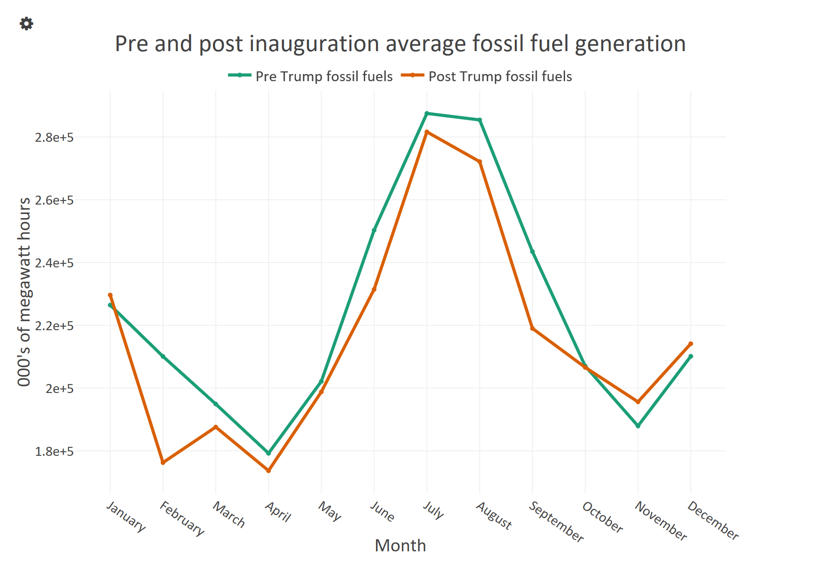
Notes:
And that is what this shows for the fossil fuels. And we can see more clearly the annual pattern, but also that there appears to have been little difference in the average monthly generation numbers.
Pre trump looks very slightly higher, in fact.

Slide 5
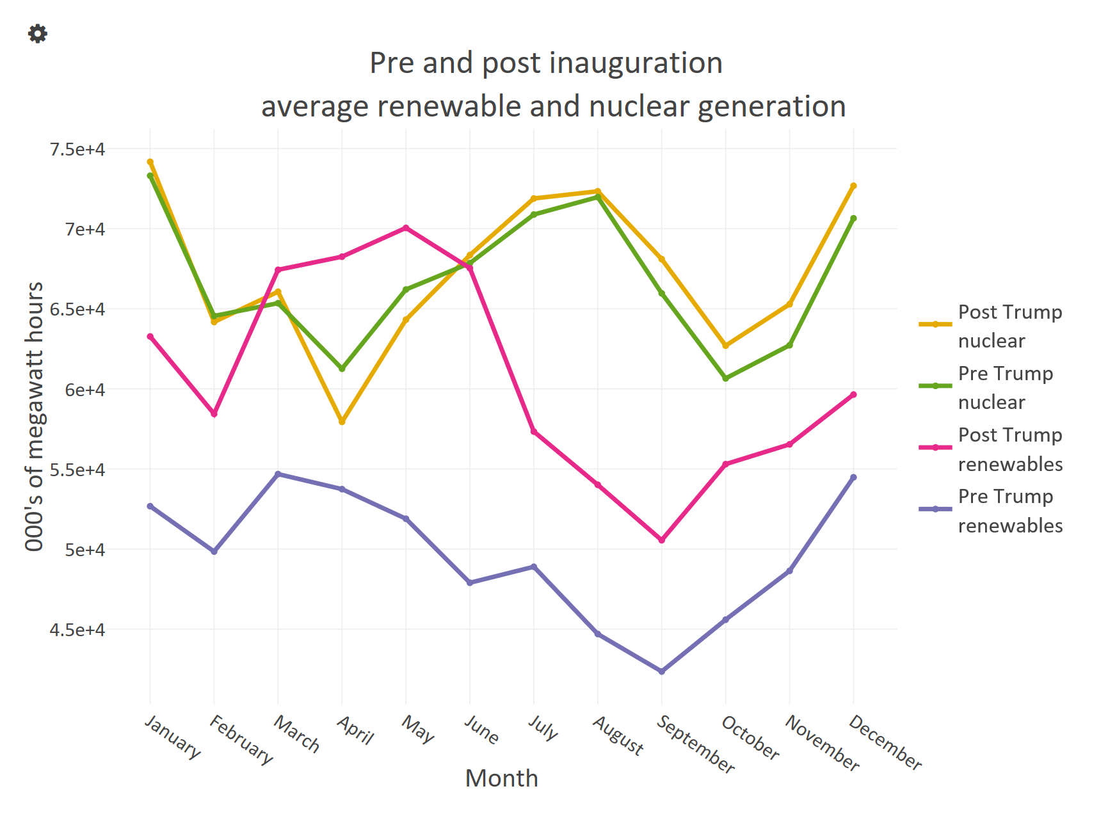
Notes:
This chart shows the same thing, but for renewables and nuclear.
Renewables we can definitely see an increase in the monthly generation, yay!
This was more of a qualitative look, but given we are doing data science I thought I would get more scientific and do some testing.

Slide 6
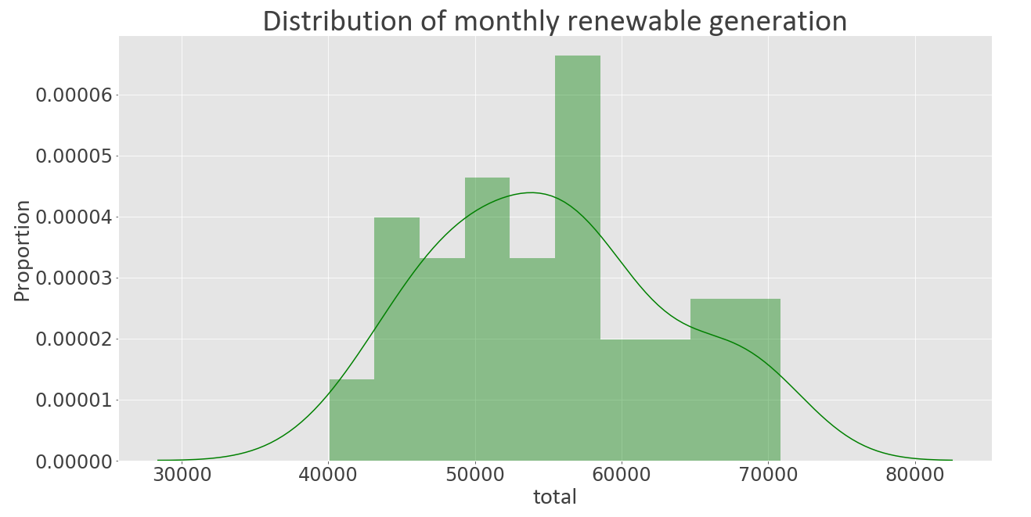
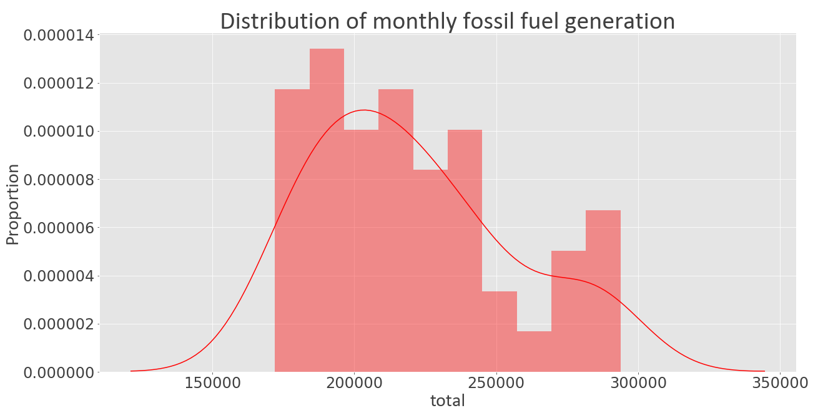
Checking for normality
Renewable summary statistics (energy values in 000’s of MWh’s)
Count | 49
Mean | 55,134
Median | 54,899
Standard deviation | 8,012
Mean – median difference | 0.43%
Fossil fuel summary statistics (energy values in 000’s of MWh’s)
Count | 49
Mean | 220,246
Median | 213,917
Standard deviation | 34,752
Mean – median difference | 2.87%
Notes:
The set-up here is I have treated the data set before the inauguration, and the data set after the inauguration, as being two samples, drawn from a population which is the data set for the full period from Jan 2015 to Jan 2019.
Given I have two samples and want to check for a difference in their mean, I would like to use a two-sample t-test. But to do that, we need to satisfy the assumptions of the test:
Equal population variances (should be satisfied as they are actually from the same population, but to be safe I have used Welch’s t-test where this assumption is relaxed)
Randomly drawn and independent sample observations.
Well, the generation in one month is not a function of the generation in another. But, it is not like every month we knockdown all the existing wind turbines and power stations and then build a random amount again before the next month, so the numbers are related.
Normally distributed population – that’s what we are checking here.
We can see from the plots that neither population is particularly close to the normal, but the renewable plot probably looks slightly better.
And on a simple measure of skewness it seems to be less skewed than the fossil fuel data.
I also ran a few statistical tests, which seemed to corroborate what we are seeing here, and so as an approximation I am going to say that the monthly renewable generation data is approximately normally distributed, but the fossil fuel data is not.

Slide 7
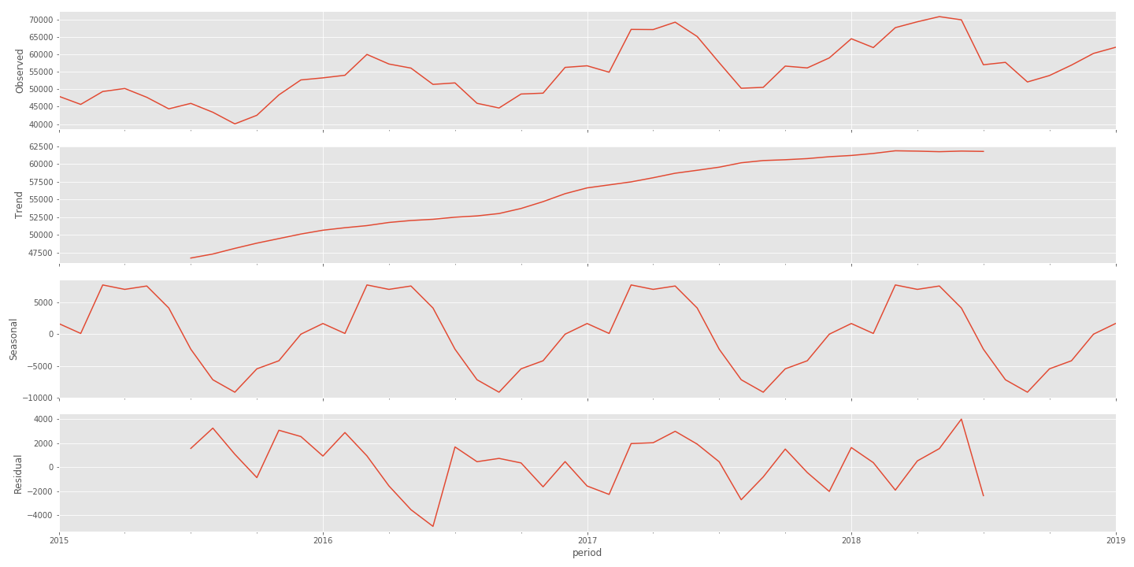
Overall renewables
Welch’s two sample t-test for the pre and post trump renewable generation data gives a p-value well below the 5% threshold
Reject the null hypothesis that the mean renewable generation before and after T-Day is the same
But time series decomposition shows the increasing trend:
Notes:
So, I went ahead and did a two-sample t-test on the renewables data from before and after Trump was inaugurated, and indeed there was a statistically significant difference, and I was able to reject the null hypothesis that the means either side of the inauguration were the same.
But, that is not quite the complete story. I apologise for the tiny text in these charts, I could not for the life of me figure out how to edit the plot. What this shows is a classical time series decomposition of the renewable energy data during the whole 2015 – 2019 period.
There are two options for forming the decomposition, a multiplicative or an additive model. I went with the additive because the magnitude of the variation of the time series didn’t appear to vary with the level of the time series.
So this assumes a model of the time series which is a trend component (the long term progression of the series), which we see here at the top.
And added to that is a seasonal component, which is this component that fluctuates with a fixed frequency.
Then finally there is a noise component, which describes random, irregular influences – basically the remainder of the time series after the other components have been removed.
And what this shows which thankfully isn’t too much of a surprise is that the renewable energy generation is growing and has been for a while.

Slide 8
Conclusions
There is a statistically significant change in renewable generation between the pre and post inauguration periods, but I would attribute this to a growing industry, not President Trump
With my statistical knowledge right now, unable to say conclusively whether there has been any change in fossil fuel generation as a result of President Trump
Short answer to original question: It doesn’t appear so
Notes:
Just read the conclusions

Slide 9
Future work
Emissions data
Better time series analysis (e.g. intervention analysis)
Better/more appropriate testing
Account for lack of independency
Notes:
This project opens up lots of avenues for future work I think.
First off, if I had more time there was data that existed on US emissions too, however it was located either in an interactive table with buttons and sliders, or in a pdf, and trying to obtain it having already scraped the data I had was too much of a stretch for this project.
This project was already pushing the limits of my statistical knowledge, there are definitely more advanced ways to analyse time series and look for break points, and better ways to do the decomposition, but again they would have taken too long to teach my self and I would not have really been solid with them.
Likewise with statistical tests, there are non-parametric tests that don’t require the assumption of normality, but if I had used them here and been quizzed on them, I would have had to direct you straight to the wiki site I learnt about them on.
Finally there is the question of whether the monthly generation observations are independent. I have discussed that a little already, and here have assumed them to be independent, but in my research I did come across variations on the t-test that seemed to assume greater dependency of the observations on one another, or paired observations where you’re looking at the same measurement item twice, once before and nce after some intervention (which could be the month here).

Slide 10
Normality tests used
Problem: For small sample sizes, normality tests have little power to reject the null hypothesis and therefore small samples most often pass normality tests^{[1]}
Shapiro – Wilk test
The null-hypothesis of this test is that the population is normally distributed
Best power for a given significance
Large sample size may lead to even trivial departures from the null hypothesis being detected (i.e. testing for a ‘perfect’ normal)
D’Agostino’s K² test
The null-hypothesis of this test is also that the population is normally distributed
Calculates skew and kurtosis of the data, to check from departure from the normal. As such only has power in these regards
Anderson – Darling test
The null-hypothesis of this test is also that the population is normally distributed
Returns a list of critical values at different significance levels, to be compared with the test statistic (also returned). H₀ fails to be rejected if the statistic is less than the critical value, for each alpha
One of the most powerful for testing for departures from normality

